Slide 1
Introduction to
Programming with Python
Loops
Notes:
cat0.py

Slide 2

Notes:
flowchart TD
A([start]) --> B["#quot;meow#quot;"]
B --> C["#quot;meow#quot;"]
C --> D["#quot;meow#quot;"]
D --> E([stop])

Slide 3
while
Notes:
cat1.py

Slide 4
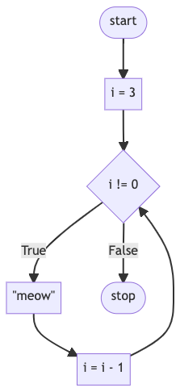
Notes:
cat2.py
flowchart TD
A([start]) --> B[i = 3]
B --> C{i != 0}
C -- True --> D["#quot;meow#quot;"]
D --> E[i = i - 1]
E --> C
C -- False --> F([stop])

Slide 5
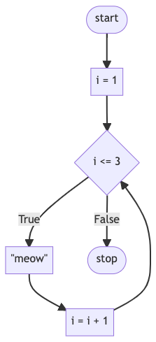
Notes:
cat3.py
flowchart TD
A([start]) --> B[i = 1]
B --> C{i <= 3}
C -- True --> D["#quot;meow#quot;"]
D --> E[i = i + 1]
E --> C
C -- False --> F([stop])

Slide 6
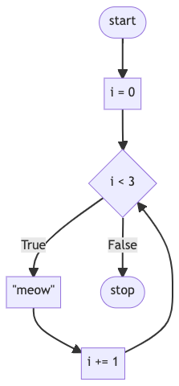
Notes:
cat4.py
flowchart TD
A([start]) --> B[i = 0]
B --> C{i < 3}
C -- True --> D["#quot;meow#quot;"]
D --> E[i += 1]
E --> C
C -- False --> F([stop])

Slide 7
for

Slide 8
list
Notes:
cat5.py

Slide 9
range
Notes:
cat{6,7}.py

Slide 10
continue
Notes:
cat{8,9}.py

Slide 11
break
Notes:
cat{10,11}.py

Slide 12
return
Notes:
cat{8,9,10,11}.py

Slide 13
list

Slide 14
Hermione
Harry
Ron
Notes:
hogwarts{0,1}.py

Slide 15
len
Notes:
hogwarts2.py

Slide 16
dict

Slide 17
 | Hermione | Harry | Ron | Draco
 | Gryffindor | Gryffindor | Gryffindor | Slytherin
Notes:
hogwarts{3,4}.py

Slide 18
 | name | house | patronus
0 | Hermione | Gryffindor | Otter
1 | Harry | Gryffindor | Stag
2 | Ron | Gryffindor | Jack Russell terrier
3 | Draco | Slytherin
Notes:
hogwarts5.py

Slide 19
None

Slide 20
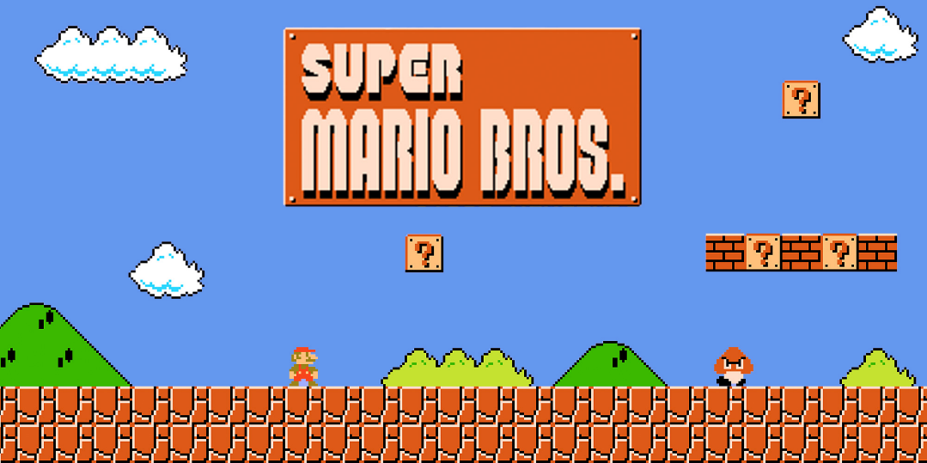

Slide 21
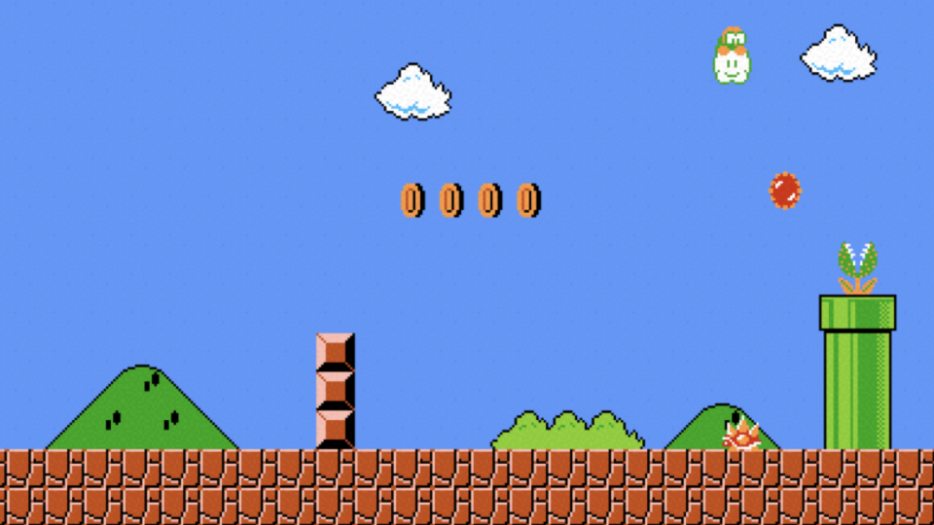

Slide 22



Notes:
mario{0,1,2,3}.py

Slide 23
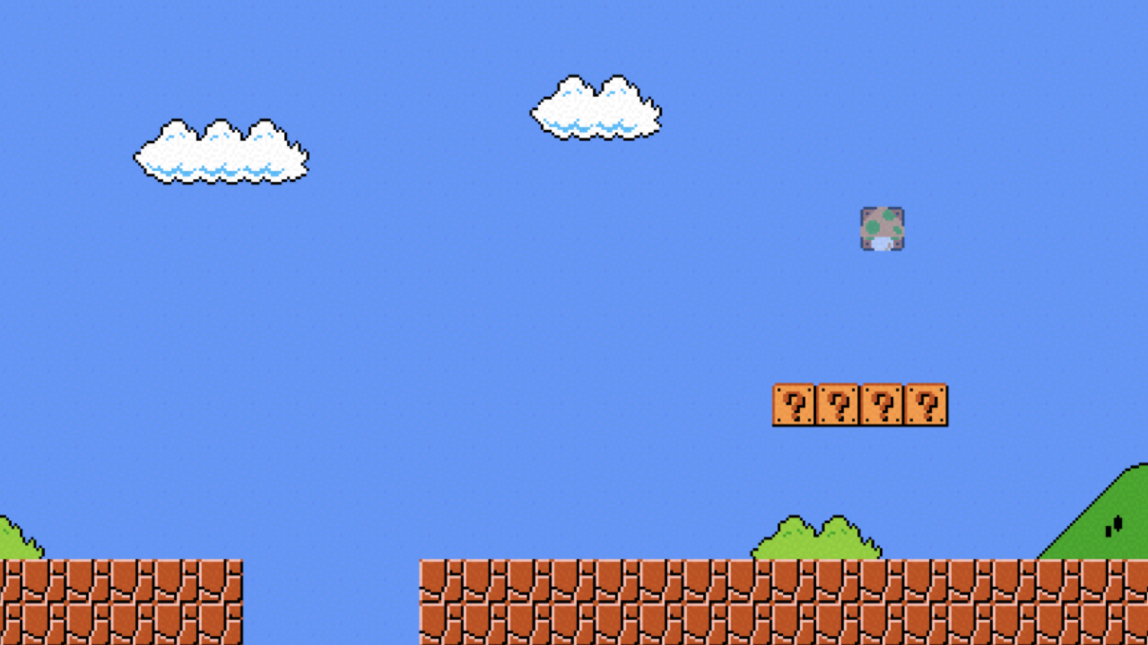

Slide 24

Notes:
mario4.py

Slide 25
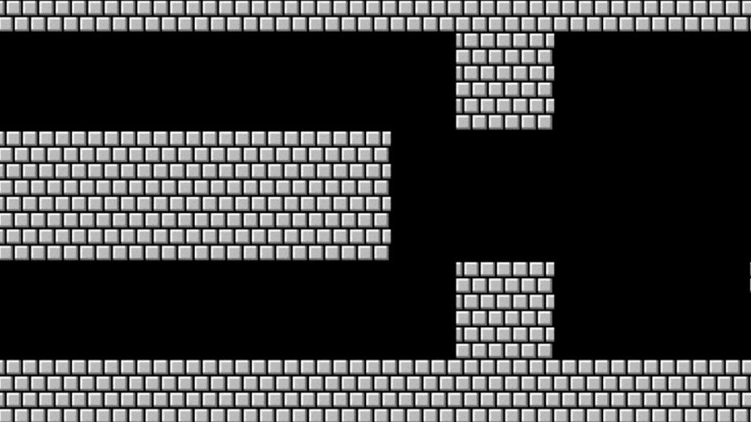

Slide 26
Notes:
mario{5,6,7}.py

Slide 27
Introduction to
Programming with Python
Loops

